Slide 1
HANDWRITTEN DOCUMENT CONVERSION
Using OCR(Optical Character Recognition)and CNN(Convolutional Neural Networks)

Slide 2
TEAM MEMEBERS
CB.SC.U4AIE24116-Lakshmi Tejaswi. J
CB.SC.U4AIE24140-Srinivas.N
CB.SC.U4AIE24143-Myagi Ranganadh. P
CB.SC.U4AIE24152-Shanmathi.M.K

Slide 3
Introduction
Handwritten documents hold valuable information, but they often face challenges in storage, retrieval, and editing
Traditional OCR (Optical Character Recognition) techniques struggle with handwriting variability, leading to low accuracy and misinterpretation
To solve this, we're building a model that combines OCR and Convolutional Neural Networks (CNNs) to accurately convert handwritten text into editable digital format.
This will make it easier to store, search, and edit handwritten documents, saving time and effort.

Slide 4
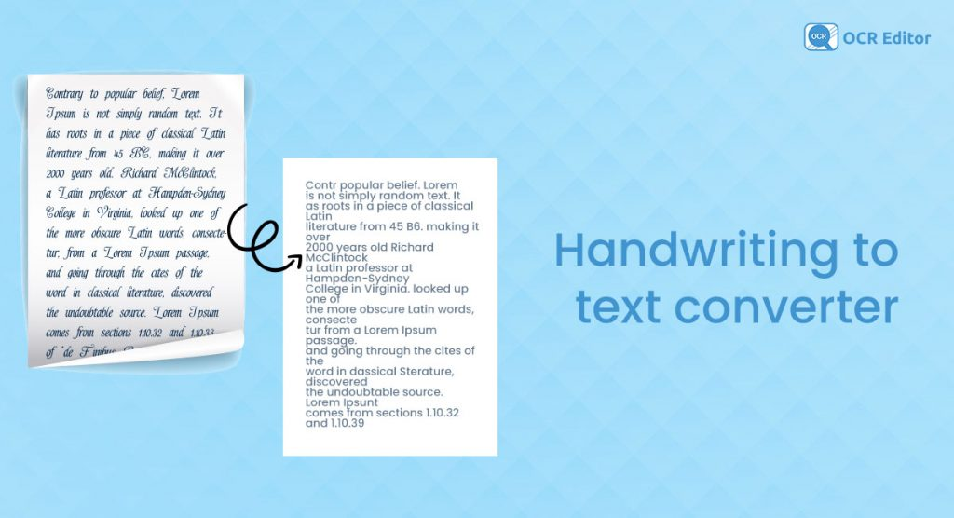
Objectives
We aim to develop a smart AI model in Python that seamlessly integrates OCR and CNN to convert handwritten documents into editable text.
This model should accurately recognize and digitize handwritten content, making it easier to edit, search, and store.

Slide 5
Advantages
Enhanced Accessibility & Searchability – Digitized text allows for easy searching, editing, and sharing, making information retrieval faster and more efficient.
Improved Storage & Preservation – Digital formats prevent physical deterioration, save space, and enable secure cloud storage with backup options.
Enhances Productivity and Workflow Efficiency – Facilitates the conversion of handwritten content into editable digital text, enabling streamlined document processing, seamless collaboration, and improved automation across various applications.

Slide 6
Literature review on paper 1
1. Methodology:
Collecting data : this step includes collecting data from two groups of Moroccan primary school pupils having ages ranging from five to ten. The collection has 30,000 photos spread across 300 pages, each bearing a Latin digit from 0 to 9.
Preprocessing data: this step includes inspecting the data to spot any problems , removing the noise and contour from the images , finally normalizing and resizing the images .
CNN model: the step includes developing a CNN model consisting convolutional layers(8 and 16 filters) for feature extraction ,followed by max-pooling,dropout for regularization , a flatten layer ,and dense layers with a softmax output for digit classification(0-9).

Slide 7
2. Advantages:
this model achieved a 80% accuracy ,0.5 loss with utilizing the real world data collected from pupils between the age 5-10
This model avoided overfitting using dropout layers which eventually improved the accuracy
3. Limitations :
Was only limited to handwritten digits
Scope to improve the accuracy
4.Dataset used:
they have collected dataset of 30,000 handwritten digit images from Moroccan primary school pupils

Slide 8
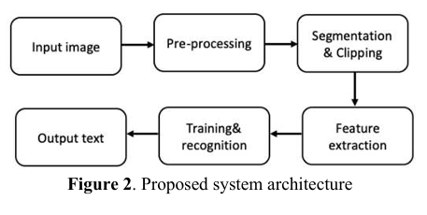
Literature Review on paper 2
1.Methodology:
Collect data: they used NIST dataset for handwritten character recognition for the CNN model
Pre-processing: this step includes noise removal from the data
Segmentation: this step includes the separation of individual characters using segmentation technique

Slide 9
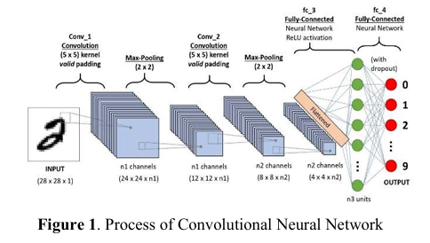
Working of CNN:
1.Convolutional layer: Applies filters to the input image to extract features (edges, textures), followed by ReLU activation for non-linearity.
2.Max Pooling layer: Reduces the feature map's size by selecting the maximum value from a small region, helping to down-sample and retain important features.
3.Flattening layer : Converts the multi-dimensional feature map into a one-dimensional vector, preparing it for input into fully connected layers for classification.
4.Fully connected layers : Connects every neuron in the layer to every neuron in the previous layer, enabling complex decision-making and final classification based on the features extracted by previous layers.

Slide 10
2.Advantages:
This model predicted handwritten characters with a high accuracy of 92.91%
3.Limitations :
further increment of training images will continue to enhance the accuracy towards to certain limit.
4.Dataset used:
They have used the dataset of handwritten characters from NIST database

Slide 11
Literature Review on paper 3
1.Methodology:
Load and pre-process the dataset
CNN model:
Two convolutional layers, the first with 16 filters and the second with 32 filters, both with ReLU activation.
There will be 2 pooling layers, and Max pooling is used.
Flatten layer: situated between the first dense layer and the last pooling layer.
There are three dense levels, the first of which has a total of 64 units, the second of which has 32 units, and the third of which has 10 units. The first two layers are activated by ReLU while the final layer is activated by Softmax.

Slide 12
2.Advantages:
This model has been tested with EMNIST and trained with MNIST ,SVHN datasets
And achieved prominent results
3.Limitations:
This model is limited to only predicting handwritten digits
4.Datasets used:
They have used MNIST ,SVHN, EMNIST datasets to test and train the model ,the accuracies are 99.08% , 96.52% , 94.03% respectively

Slide 13
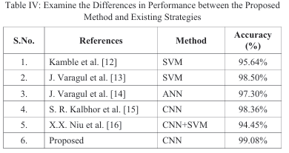
Why CNN?
Highest accuracy – Comparing the other models from the reference papers CNN achieved highest accuracy
Automatic Feature Extraction – Unlike traditional models like SVM and decision trees, CNNs learn and extract important image features without manual intervention.
Hierarchical Feature Learning – CNNs capture low-level features (edges, textures) in early layers and high-level patterns (shapes, digits) in deeper layers, making them highly effective.
Uses Convolutional Layers for Pattern Recognition – CNNs apply filters (kernels) that slide over images to detect important structures, such as curves, lines, and textures.
Pooling Layers for Feature Selection – CNNs use max pooling to retain the most important features while reducing unnecessary details, improving efficiency.

Slide 14
Research Gap
These papers didn’t include the recognition of special characters like(@,#,&,$..)in the handwritten documents.
Essential in financial records, coding notes, and mathematical documents.
Most of the studies focus only on recognizing handwritten text but fail to convert it into a fully editable and structured digital format .

Slide 15
Overview of the proposed methodology
Collect data :we are collecting data from the NIST database
Pre-processing the data: the collected data is pre-processed (like noise removal , gray scale conversion)
CNN model : train the CNN(Convolutional Neural Networks) model in python to detect and classify the handwritten digits and characters
OCR : we will be using OCR(Optical Character Recognition) for converting the output into editable text format.

Slide 16
Datasets for our model
This is the dataset for character and digit recognition:
https://www.kaggle.com/datasets/tanay27/handwrittennist
This the dataset for special character recognition(@,#,$,&):
https://www.kaggle.com/datasets/vaibhao/handwritten-characters

Slide 17
References
[1] Dr. Mrinal Paliwal, Dr. Sunil Kumar Chawla, and Dr. Punit Soni , “ Digit Recognition by the Implementation of Supervised Learning Using a Convolutional Neural Network”,2023
[2] Khalil Ladrhama , Hicham Gueddahb, “Advanced OCR for Digits Exploring CNN for Optimal Performance”,2023
[3] I Khandokar, Md M Hasan, F Ernawan, Md S Islam, M N Kabir, “Handwritten character recognition using convolutional neural network”,2021

